Slide 1
Digi Kabootar
Gen Al-Based Email Classification and OCR
Team Members: Shreema S Ajila, Vaishali Agarwal, Maehul Kumar,
Guddy Kumari, Niraj Dewangan

Slide 2

Introduction
1
Agenda
How We Built It - Approach
2
Challenges
Topics Covered
3
Results
4

Slide 3
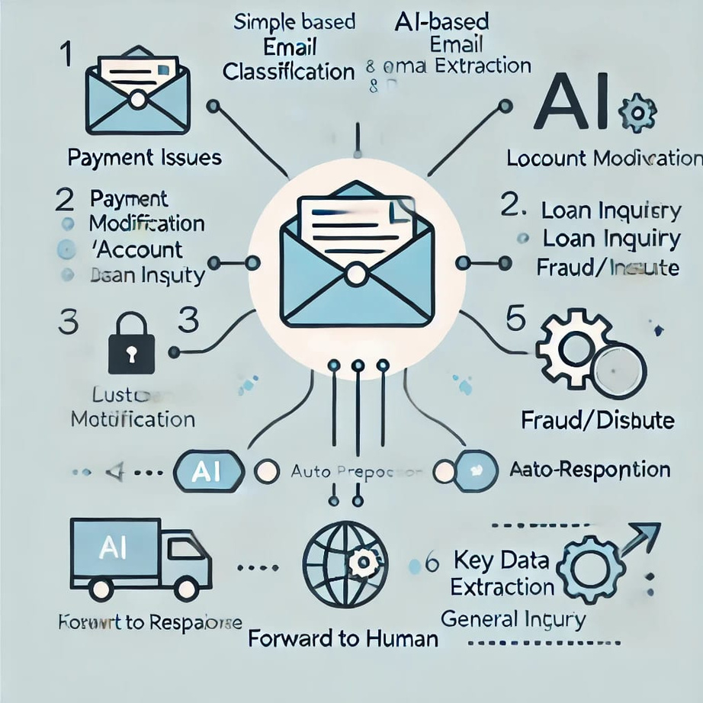
Introduction
Automating email classification and data extraction for commercial bank lending services

Slide 4
Problem Statement: Manual triage process is time-consuming, error-prone, and inefficient when handling large volumes of emails
Goal: Develop a scalable, efficient solution using Gen AI to improve loan servicing workflows

Slide 5
How We Built It - Approach

Slide 6

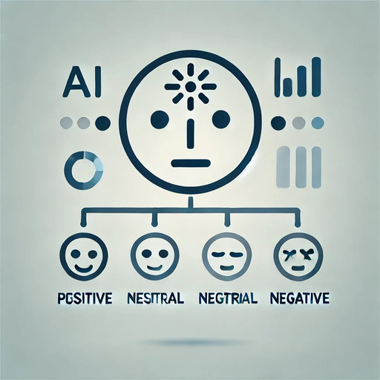

Problem Definition
Data Preparation - Datsets
Model selection & Fine tuning
How each of the manual tasks can be automated using GenAI without human intervention.
Gather Datasets
rule based Classification
Text preprocessing
Tokenization
Try out different models to get the precised output
How We Built It - Approach

Slide 7
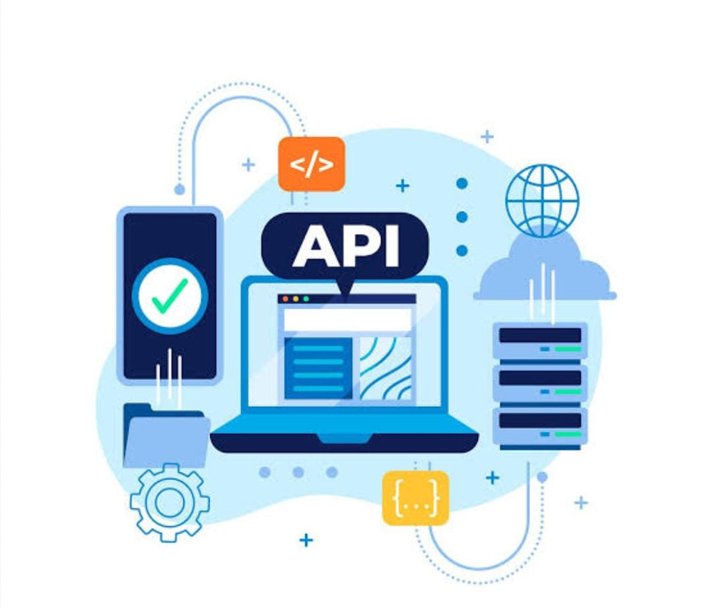

API integration
Evaluating Output
Integrating UI with datasets input to interact with Model build and generate the result
Prioritization, field extraction, duplicate detection, confidence score
How We Built It - Approach

Slide 8



Finding accurate Datasets
Unstructured Emails, Noisy Data, Class Imbalance, Lack of Labeled Data
Selecting the right Model
Challenges
Overfitting, handling multi label classification(mail trail), getting precised output with free model
Preprocessing Data
Context understanding

Slide 9

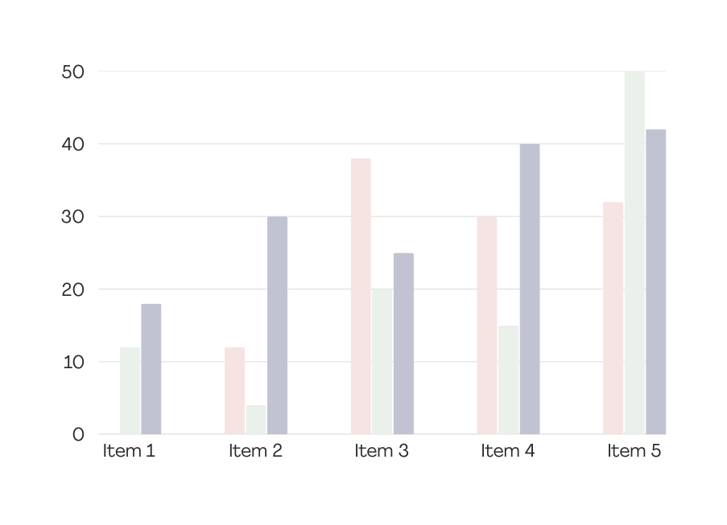
Results

Slide 10
7 out of 7
Elaborate on the featured statistic.
100%
Elaborate on the featured statistic.
7 crore
Elaborate on the featured statistic.

Slide 11
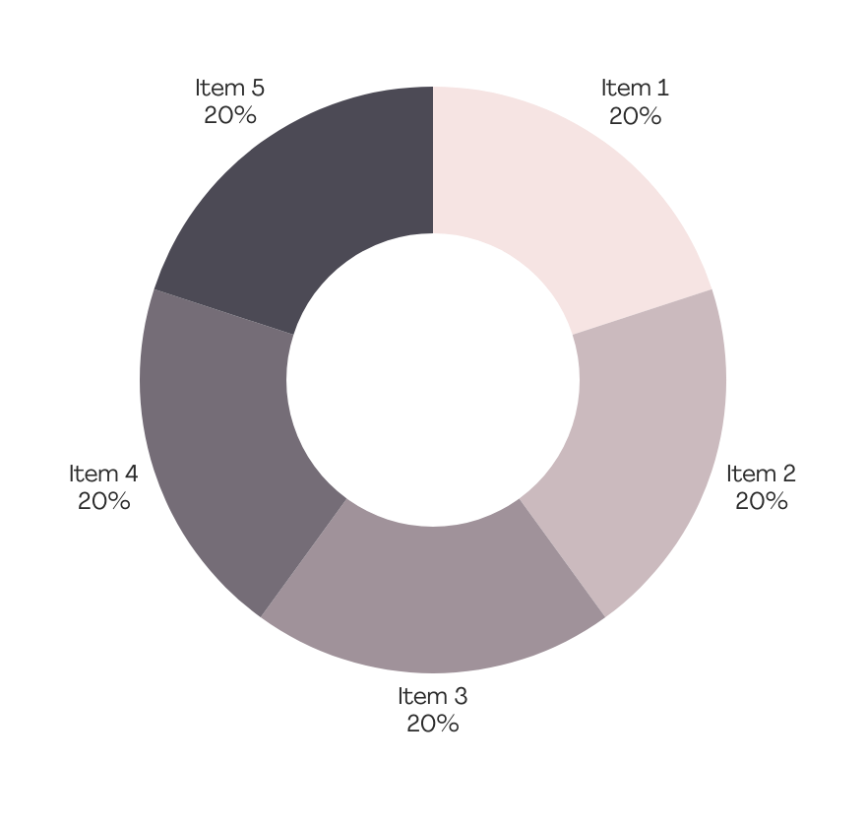
Write your
topic or idea
Briefly elaborate on what
you want to discuss.

Slide 12
Thank you!

